Slide 1

Cheque Depository Regulation System
Presented By- Under The Guidance Of- Group Number-13 Mr. Nilesh Patel
Divya Shah (141214) Khyati Kachhawah (141239) Sakshi Saxena (141311)

Slide 2
Contents
Current Scenario
Use Case Diagram
Sequence Diagram
Activity Diagram
Entity Relationship Diagram
Data Flow Diagram
Screenshots
Conclusion

Slide 3
Current Scenario
The current system of depositing a cheque follows the process of scanning the cheque and uploading its images. Therefore, verifying and depositing the cheque. While, on the other hand our system does not follow this conventional method.
Objective In our system, we will not be using the physical cheque, that has to be filled at the time of issue. We will be generating the cheque on the basis of payee and account holder, amount, phone number .
The information regarding the transaction will be secured by using the QR Code. This QR Code will be unique for every transaction .
The QR Code can either be directly scanned or can be printed and then scanned.

Slide 4
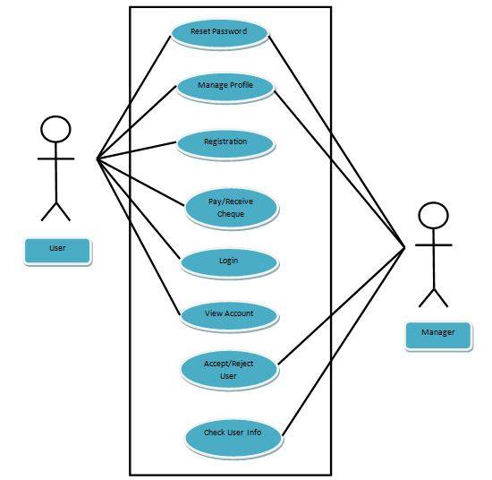
Use Case Diagram

Slide 5
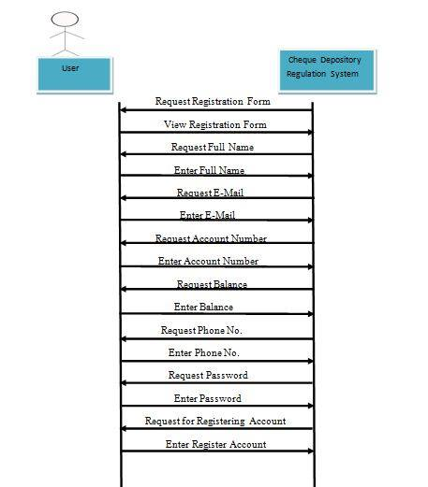
Sequence Diagram for Registration

Slide 6
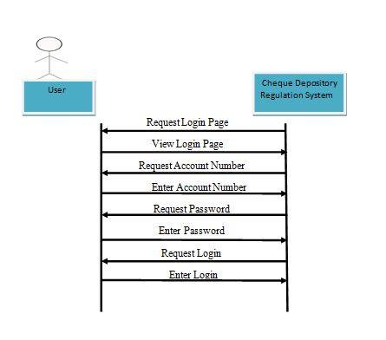
Sequence Diagram for Login

Slide 7
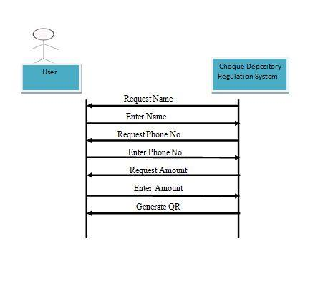
Sequence Diagram for Pay

Slide 8
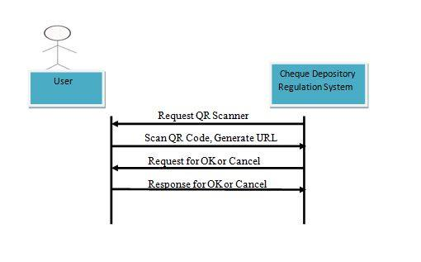
Sequence Diagram for Receive

Slide 9
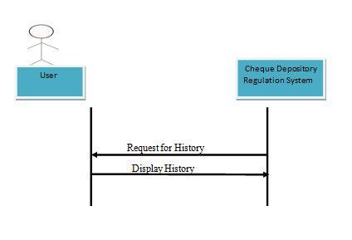
Sequence Diagram for History

Slide 10
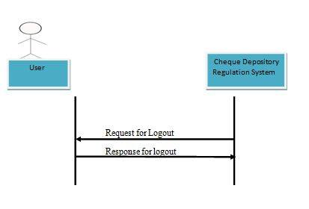
Sequence Diagram for Logout

Slide 11
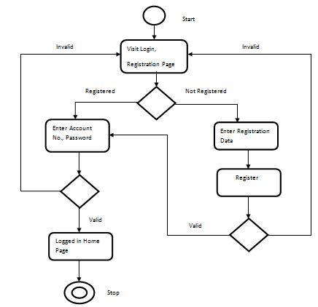
Activity Diagram for Registration and Login

Slide 12
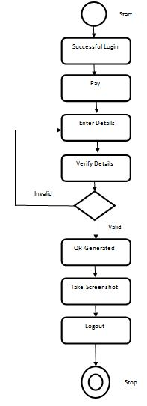
Activity Diagram for Paying a Cheque

Slide 13
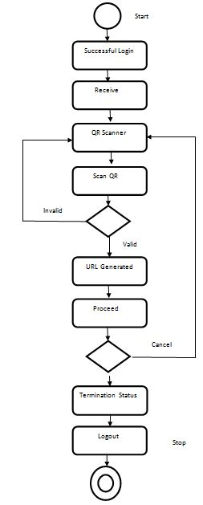
Activity Diagram for Receive a Cheque

Slide 14
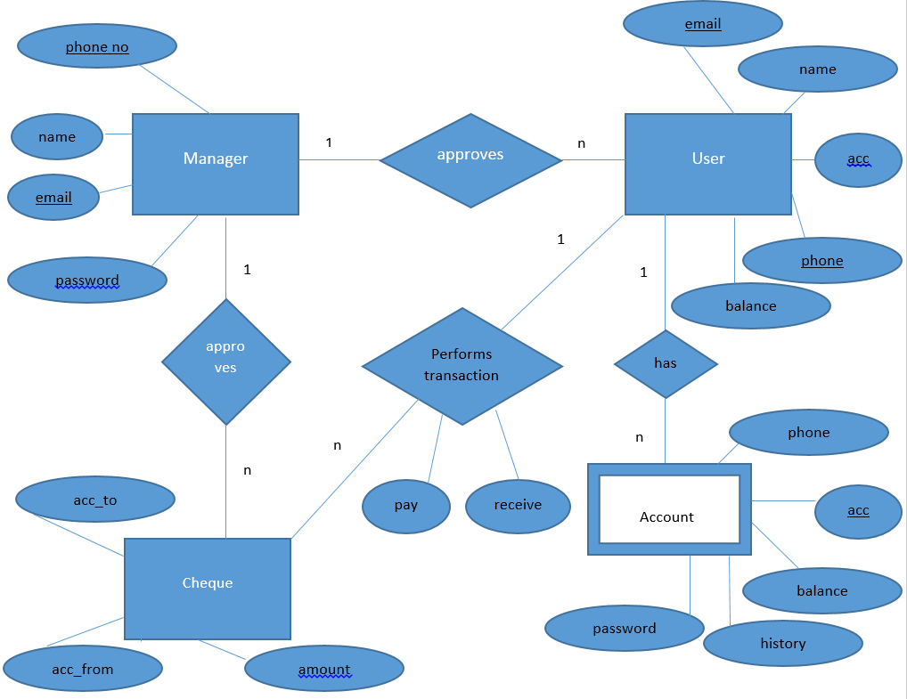
ER Diagram

Slide 15
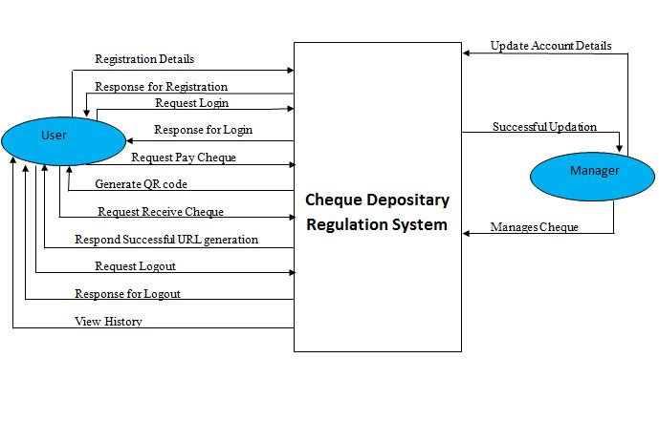
Level 0 DFD

Slide 16
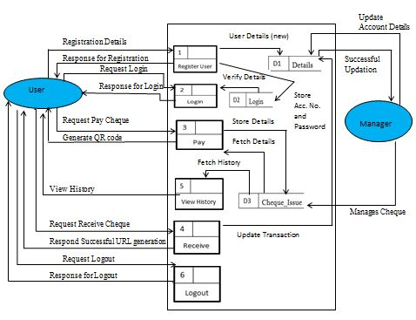
Level 1 DFD

Slide 17
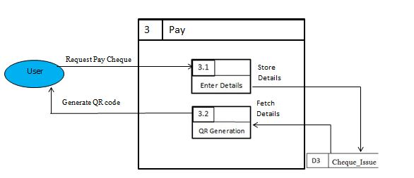
Level 2 DFD

Slide 18
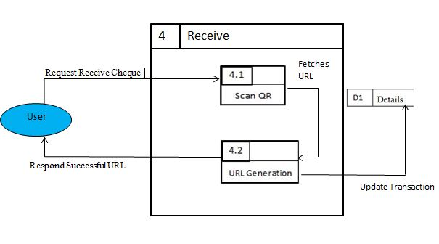
Level 2 DFD

Slide 19
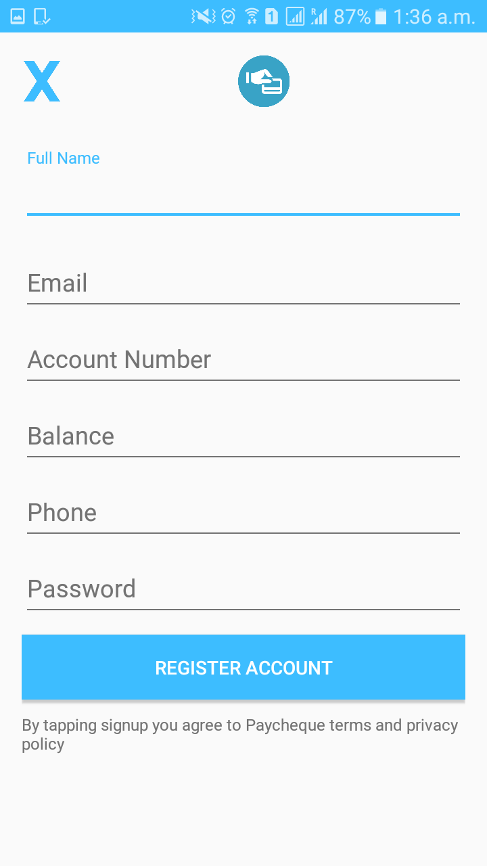
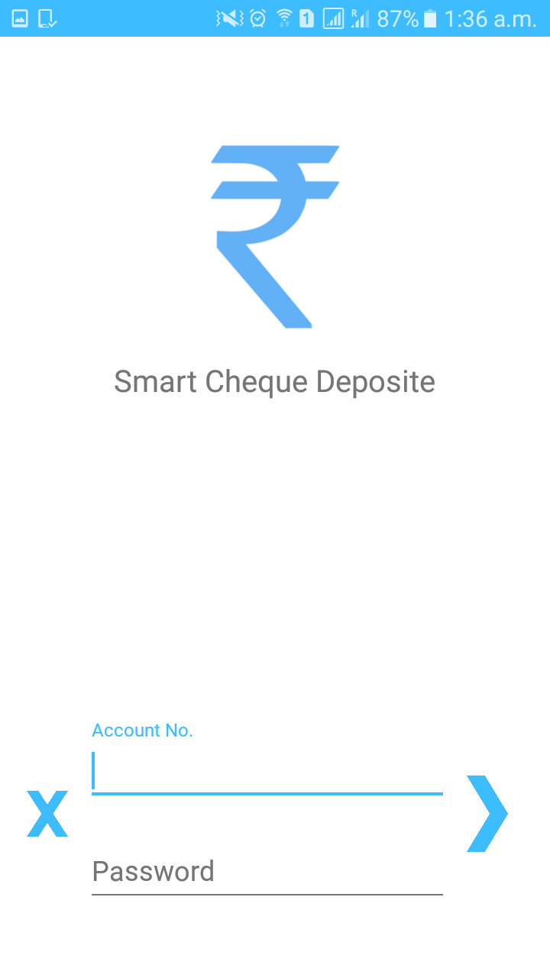
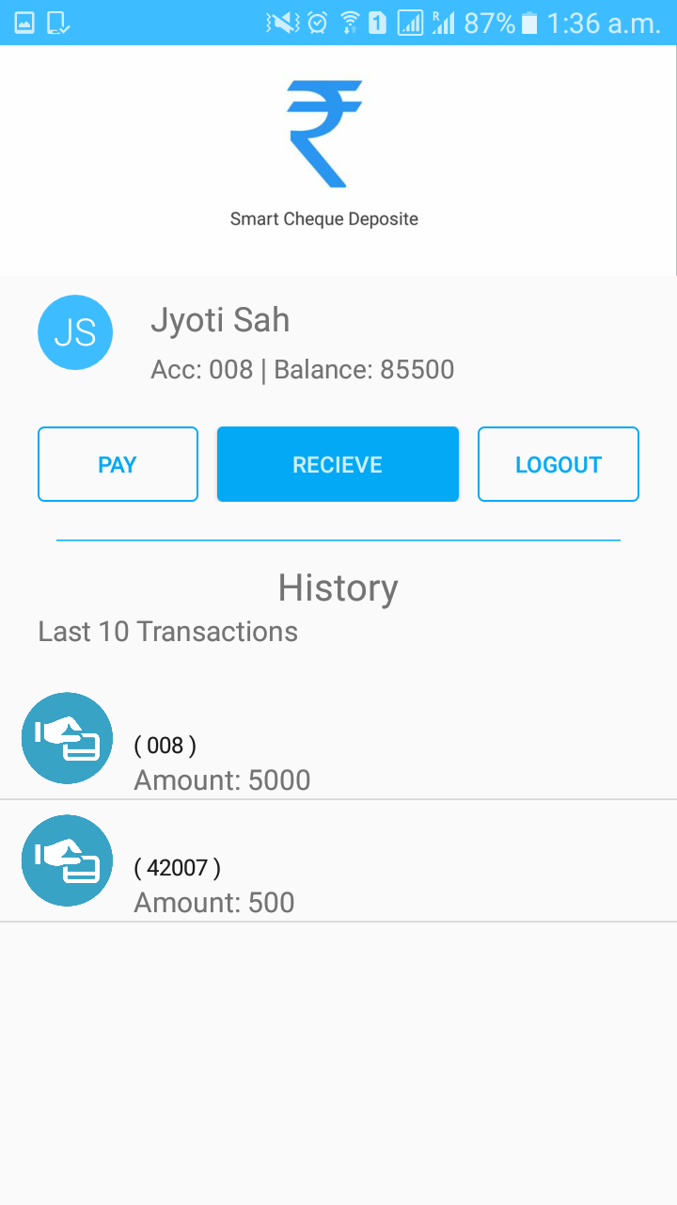
Screenshots

Slide 20
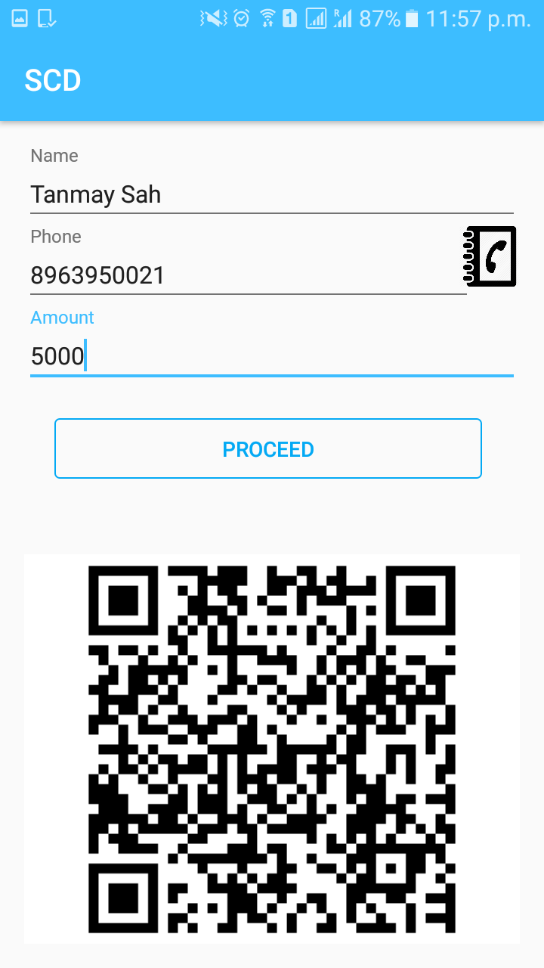
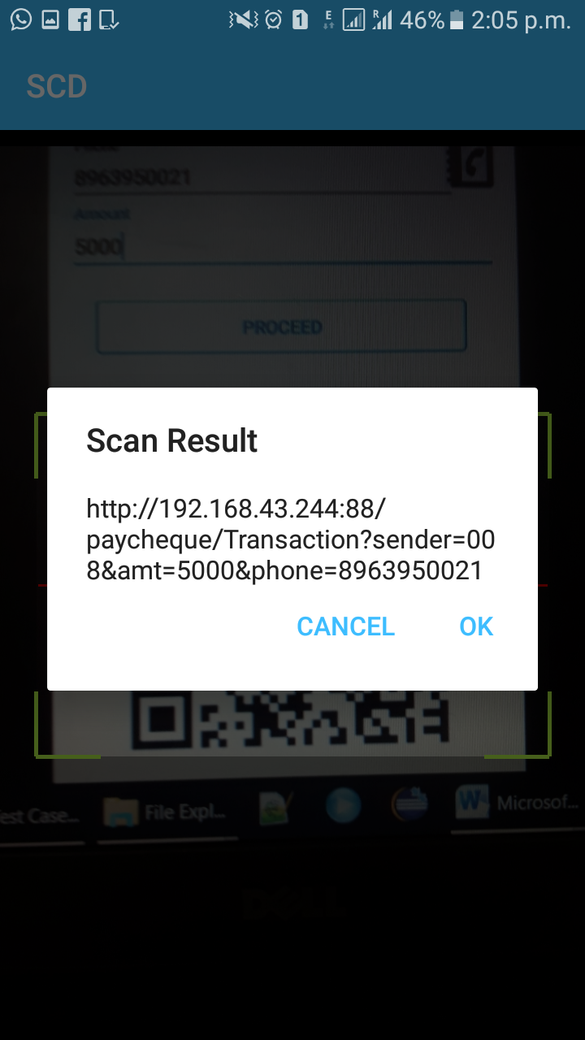

Screenshots

Slide 21
Conclusion
A systematic and easy way of depositing a cheque is much needed application in the present area. If the small difficulties and problems can be eliminated, the software will be of great help in the real life scenario.
Services
Cheque Deposit
Pay
Receive
Cheque Transaction History
Cheque Cancellation Facility
Security
Account linked through registered phone number.

Slide 22
THANK YOU

